Slide 1
Temporal recalibration project Model fitting results
221020

Slide 2
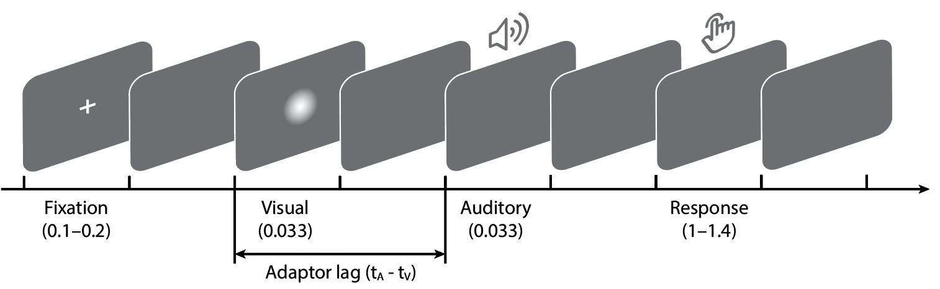
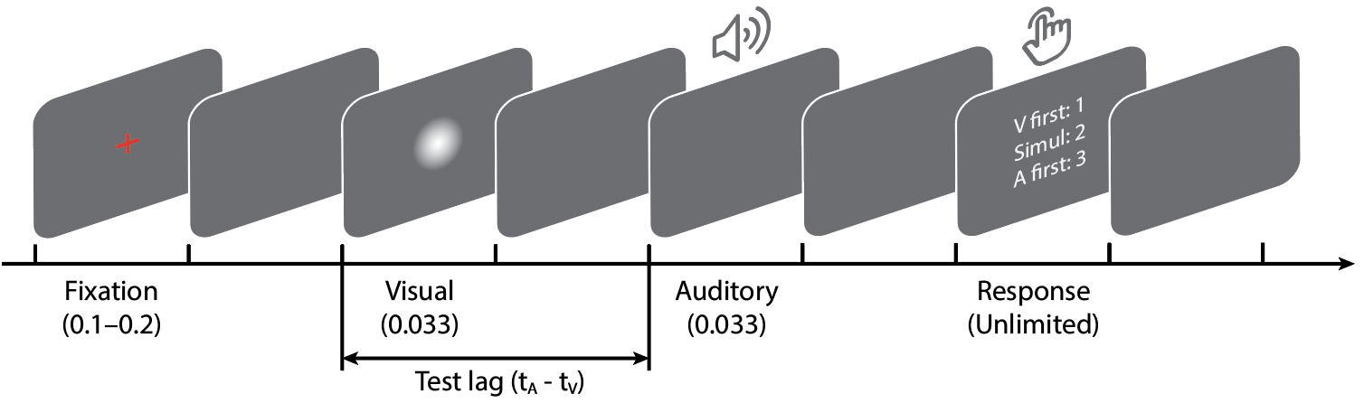
Recalibration task
Session 1
Oddball task
Pre-test × 300
Exposure × 250
Post-test × 300
prd = 1; for i = 1:length(s)
prd = prd * normpdf(s(i),mu,1); end
Temporal order judgement task

Slide 3
Behavioral results
n = 9
mean recalibration effect
error bars: S.E.M. across observers

Slide 4
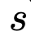
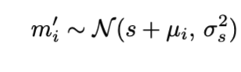
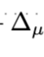
Bayesian causal inference model
1. Measurement of SOA
adaptor SOA (s) that is fixed within each exposure phase
The observer remaps it into the internal space relative to the PSS (μ_i ) in each trial
We use μ_i to denote the cumulative shift of PSS by the end of each trial, μ_0 = μ_pre, and μ_250 = μ_post, is the cumulative shift.
Observer then makes a noisy sensory measurement of SOA, m′
Notes:
adaptor SOA (s) that is fixed within each exposure phase
The observer remaps it into the internal space relative to the PSS (μ_i ) in each trial
We use μ_i to denote the cumulative shift of PSS by the end of each trial, μ_0 = μ_pre, and μ_250 = μ_post, is the cumulative shift.
Observer then makes a noisy sensory measurement of SOA, m′

Slide 5
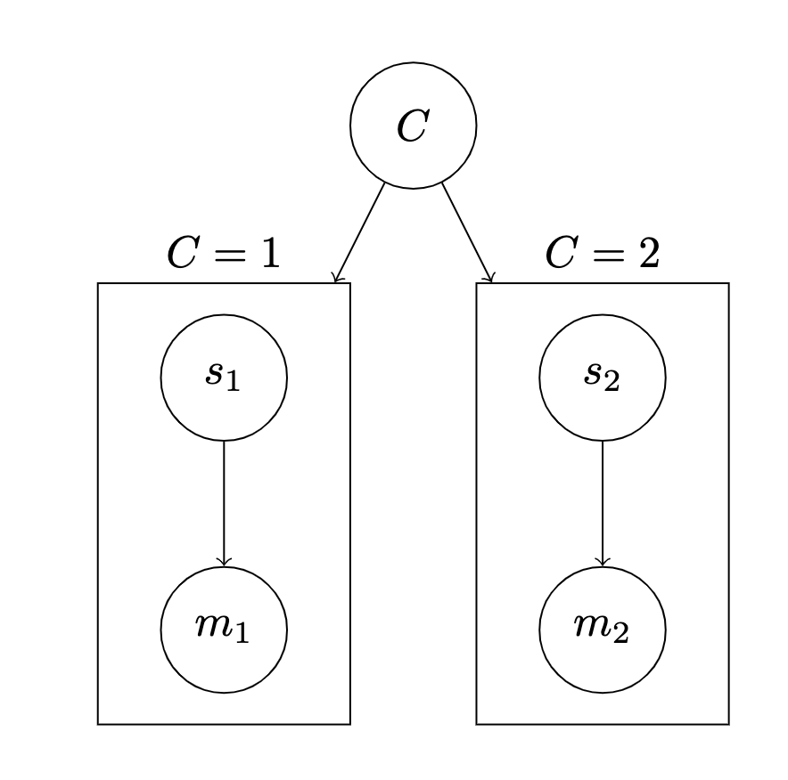
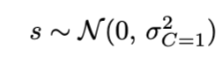
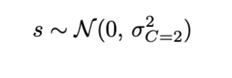
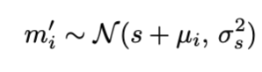
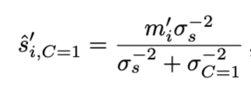
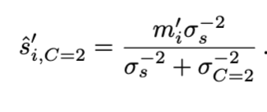
Bayesian causal inference model
1. Measurement of SOA

Slide 6
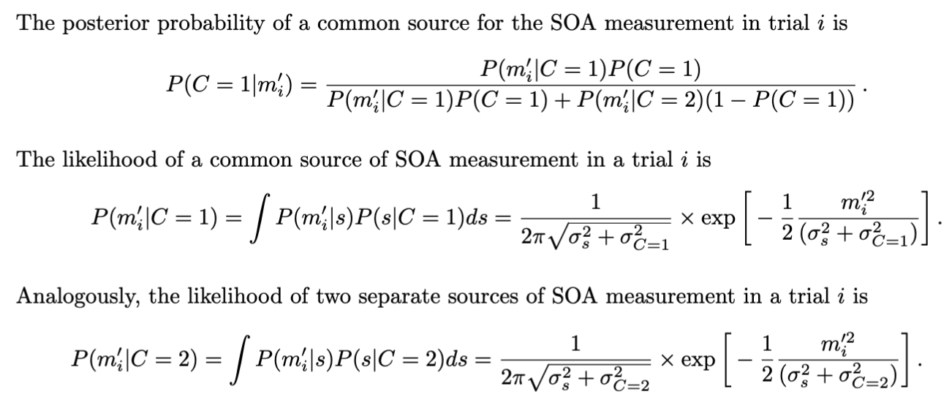
Bayesian causal inference model
2. Posterior of a common cause

Slide 7
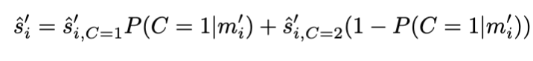
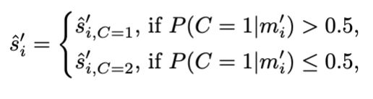
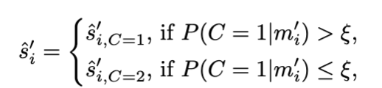
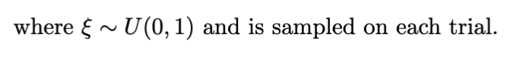
Bayesian causal inference model
3. Compute the final estimate
Model average
Model selection
Probability matching

Slide 8
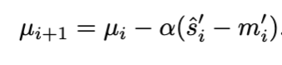
Bayesian causal inference model
4. Recalibration by update
?
The mean of measurement in each trial is updated by the discrepancy between the estimate and measurement
(next trial) 1. Measurement of SOA
adaptor SOA (s) that is fixed within each exposure phase
The observer remaps it into the internal space relative to the PSS (mu) in each trial
We use μ_i to denote the cumulative shift of PSS by the end of each trial, thus μ_0 = μ_pre, and μ_250 = μ_post
Observer then makes a noisy sensory measurement of SOA, m′

Slide 9
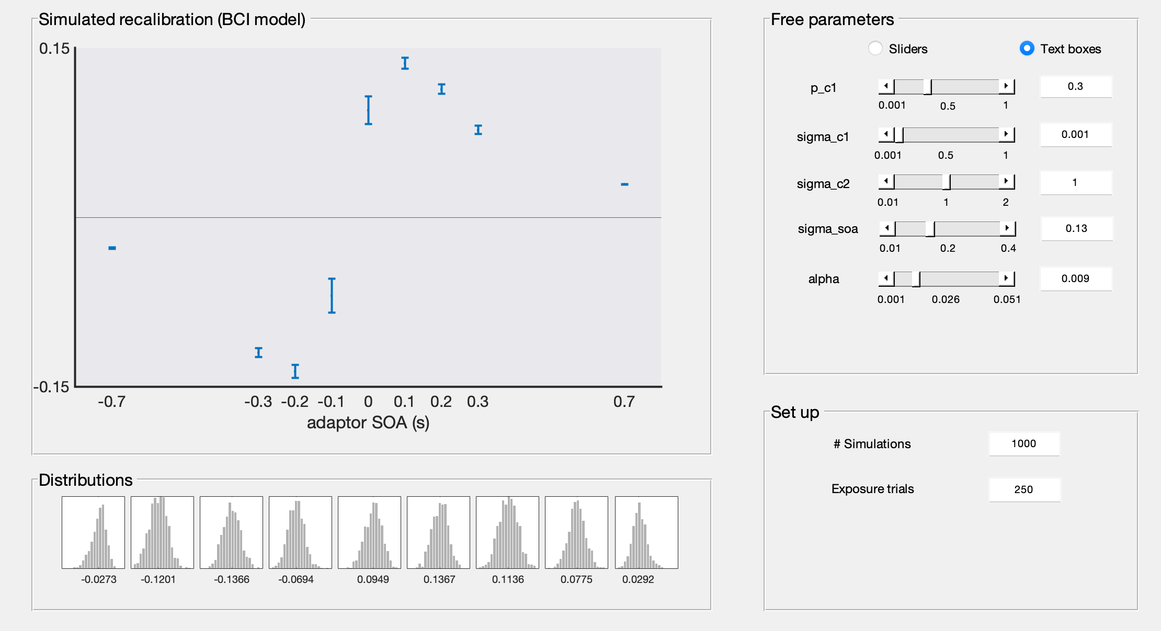
Simulation results

Slide 10
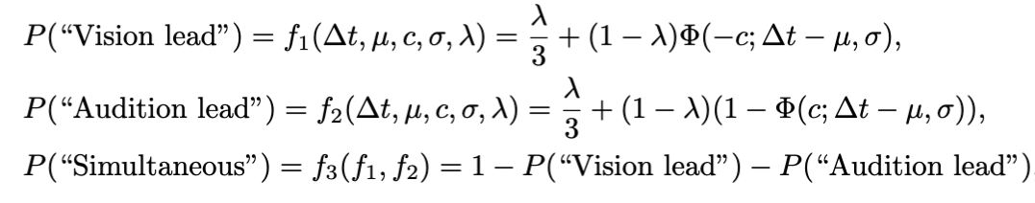
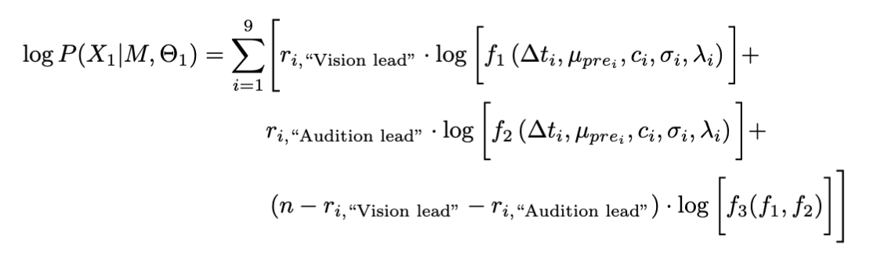
Model fitting
1. TOJ task formulation
2. Log-likelihood of pre-test

Slide 11
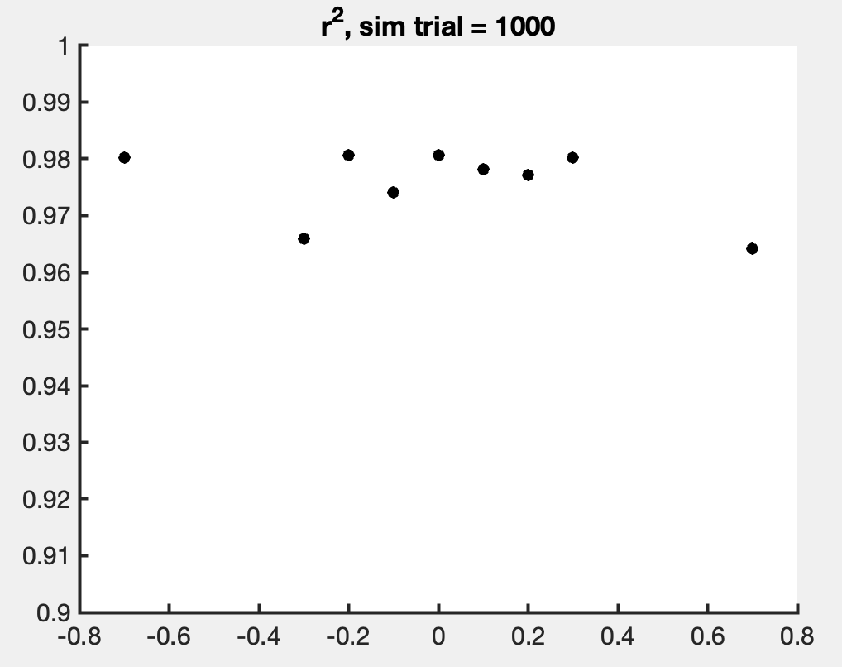
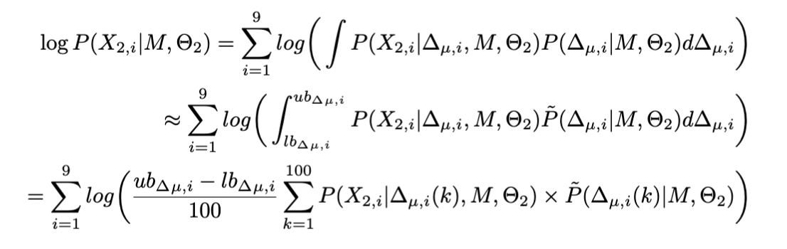
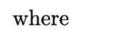
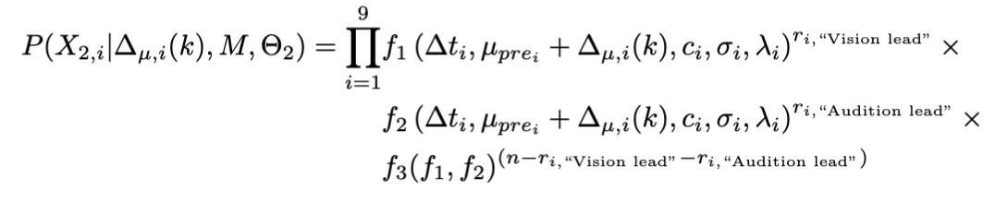
Model fitting
3. Log-likelihood of post-test

Slide 12
Model fitting
4. Free parameters and bounds
mu1 = [-0.3, 0.3]; % s
sigma1 = [0.01, 0.35]; %s
c1 = [0.01, 0.35]; % s
lambda = [1e-4, 0.06]; % percentage
sigma2 = [0.01, 0.35]; %s
c2 = [0.01, 0.35]; % s
p_common = [1e-4, 1-1e-4]; % weight
sigma_soa = [0.01, 0.2]; % s
sigma_c1 = [1e-4, 0.05]; % s
sigma_c2 = [0.2, 3]; % s
alpha = [1e-3, 0.1]; % percentage

Slide 13
Model prediction
Notes:
sub1

Slide 14
Model prediction
Notes:
sub10

Slide 15
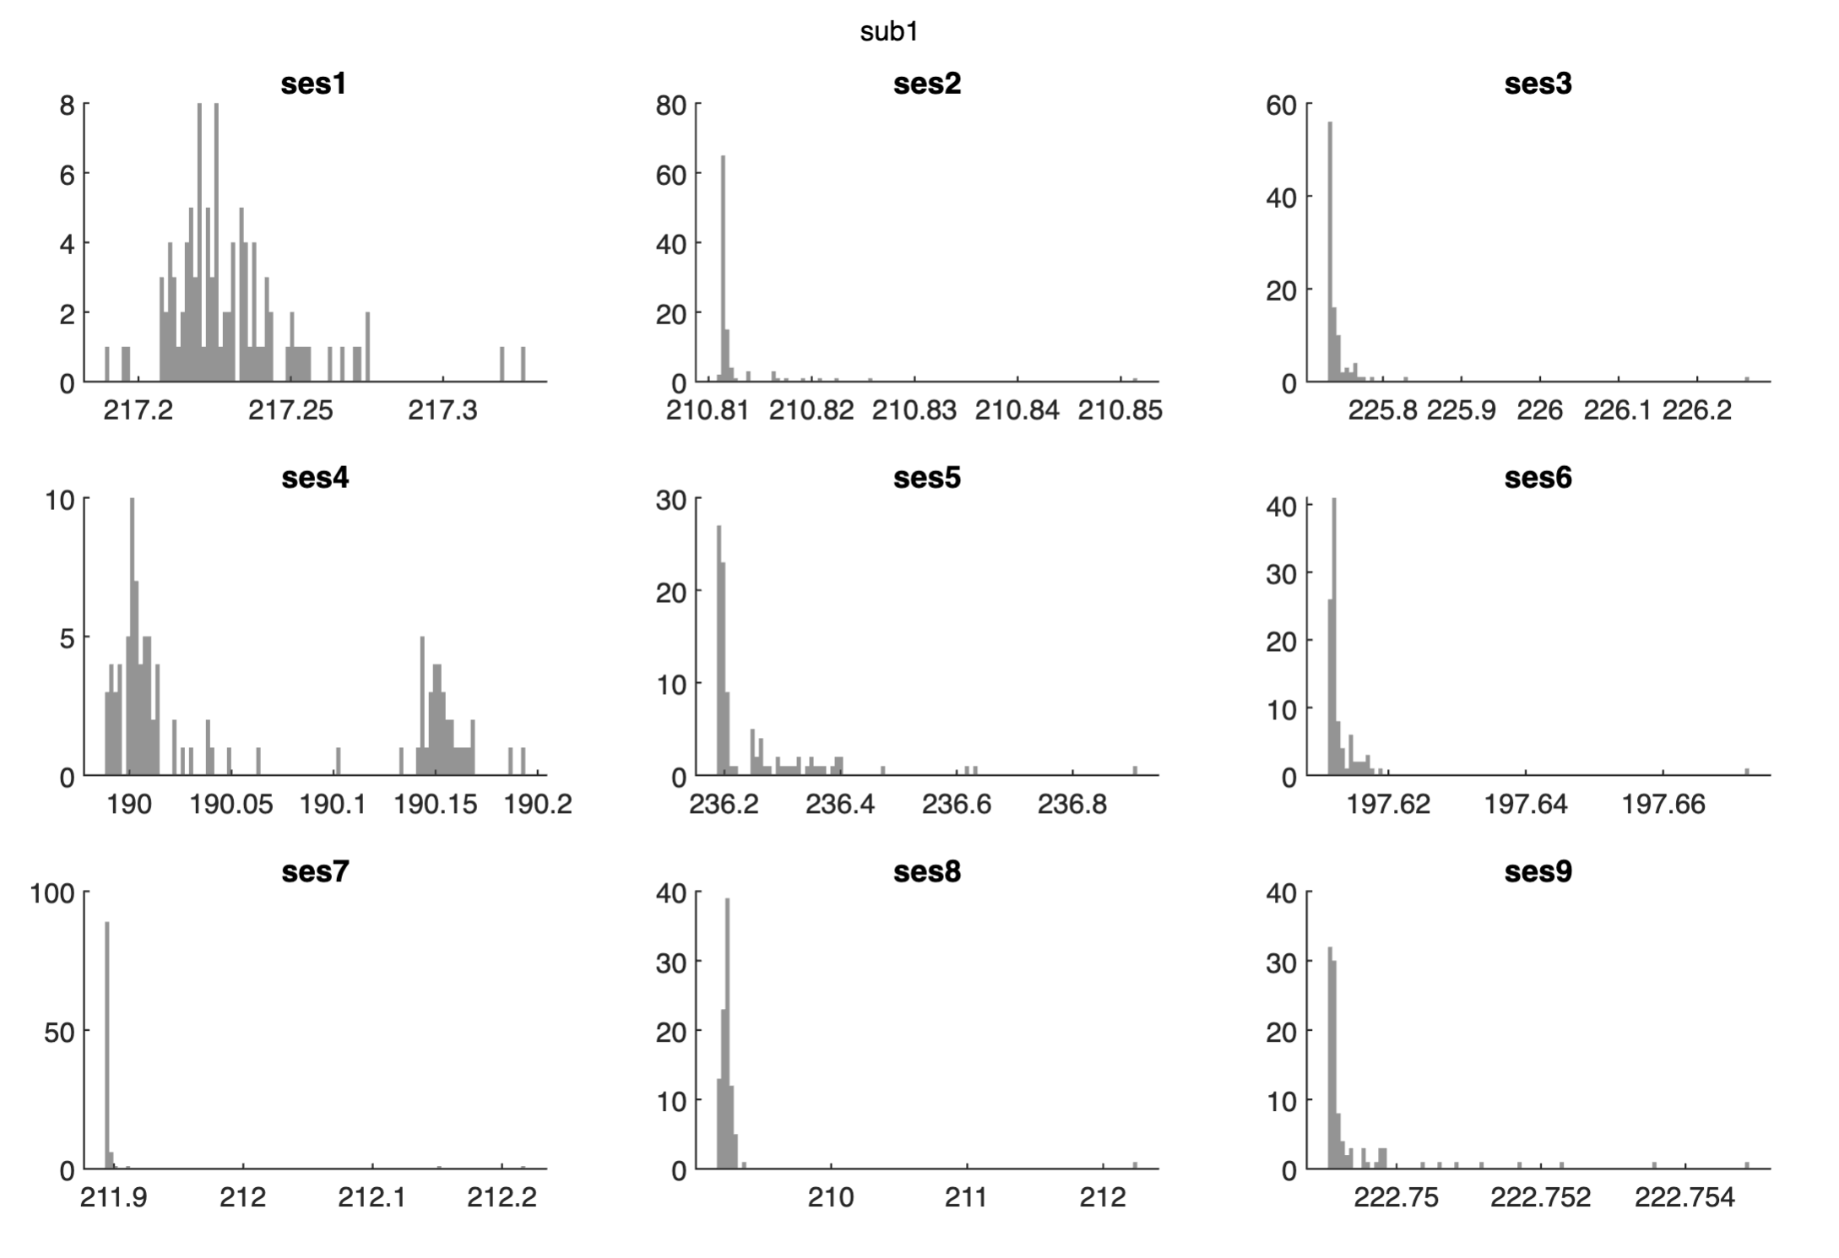
Model fitting: distribution of nLL

Slide 16
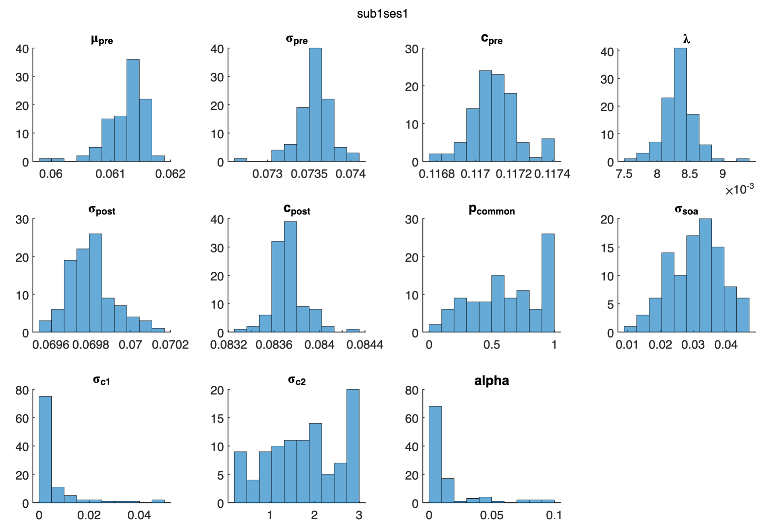
Model fitting: distribution of parameters
?

Slide 17
Model fitting: distribution of parameters

Slide 18
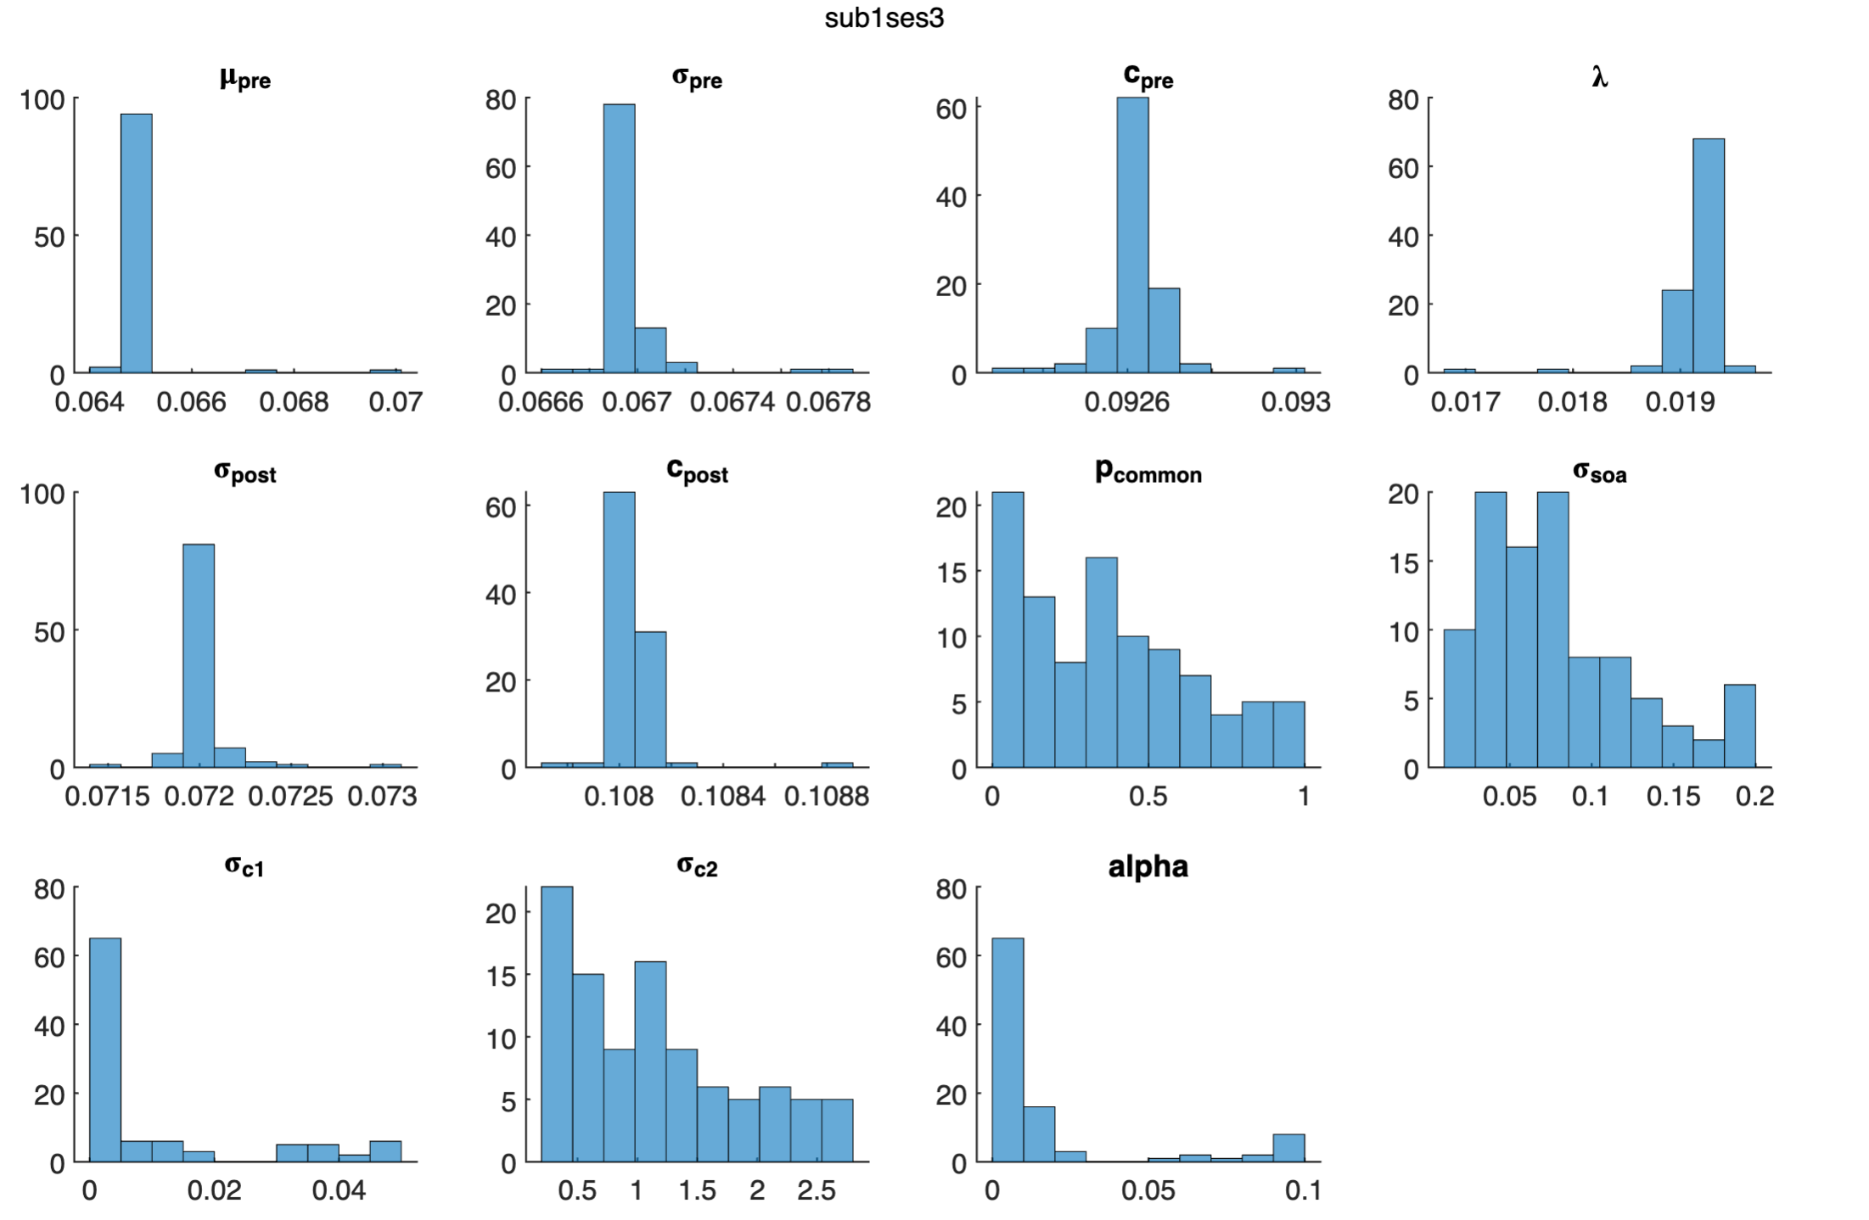
Model fitting: distribution of parameters

Slide 19
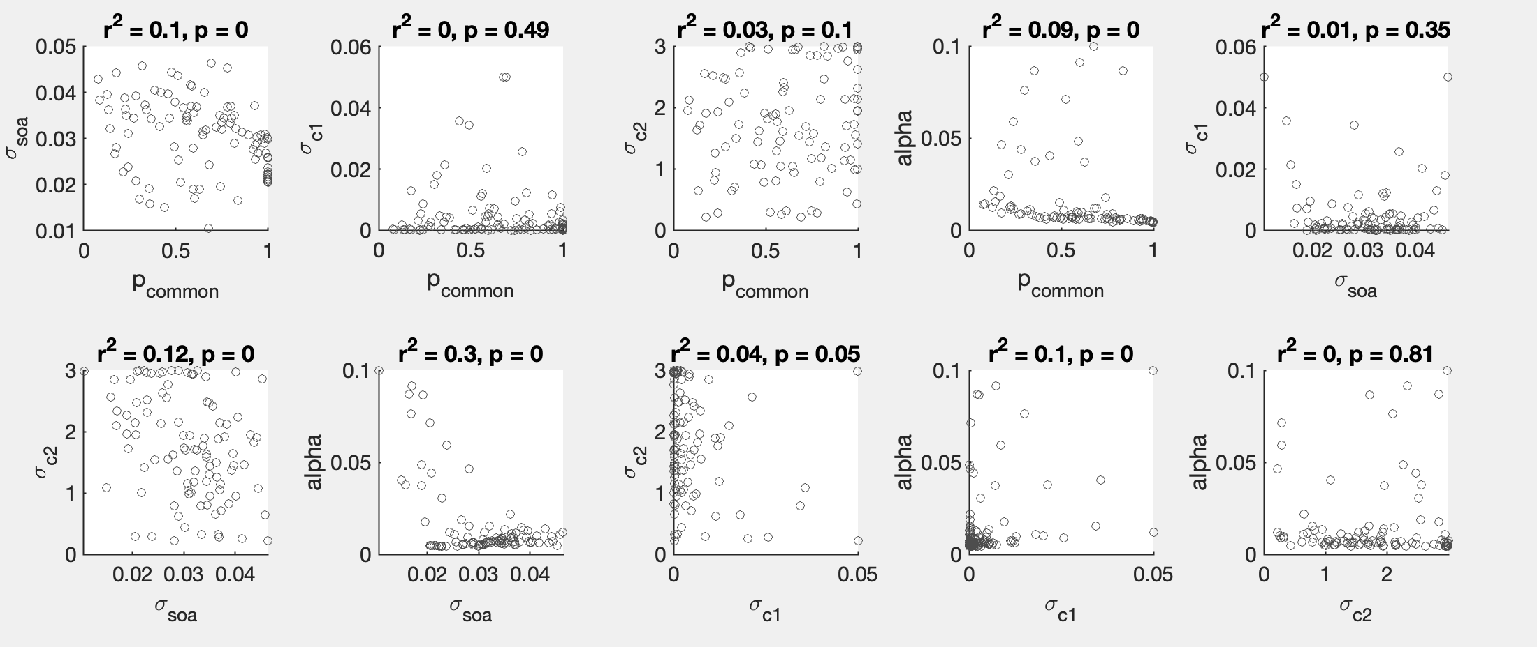
Model fitting: correlation between parameters

Slide 20
Model fitting_v2: freeze sigma_c1 and sigma_c2
4. Free parameters and range
mu1 = [-0.3, 0.3]; % s
sigma1 = [0.01, 0.35]; %s
c1 = [0.01, 0.35]; % s
lambda = [1e-4, 0.06]; % percentage
sigma2 = [0.01, 0.35]; %s
c2 = [0.01, 0.35]; % s
p_common = [1e-4, 1-1e-4]; % weight
sigma_soa = [0.01, 0.2]; % s
sigma_c1 = [0.001, 0.001]; % s
sigma_c2 = [0.8, 0.8]; % s
alpha = [1e-3, 0.1]; % percentage

Slide 21
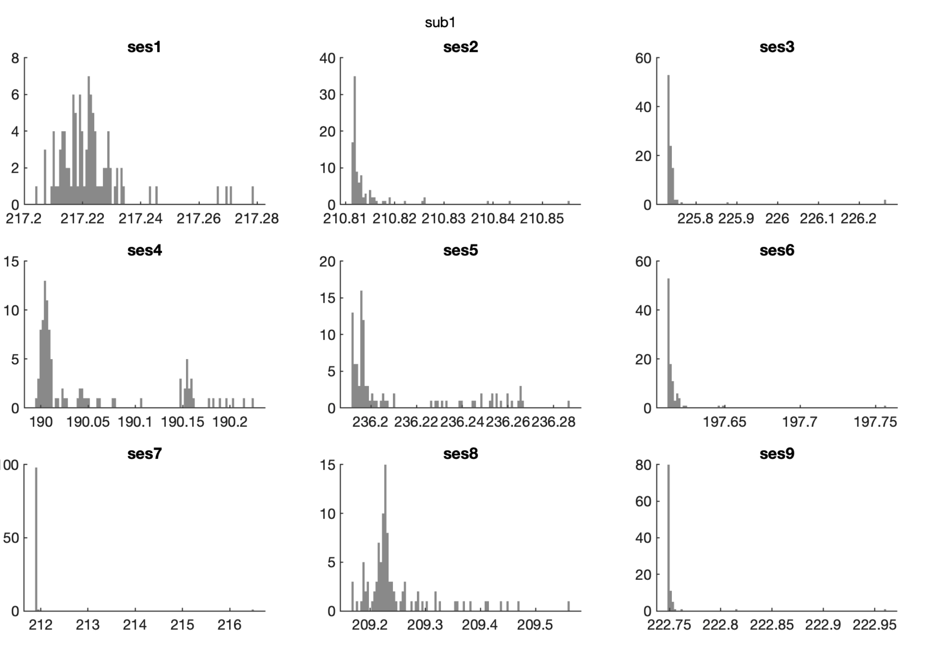
Model fitting_v2: distribution of nLL

Slide 22
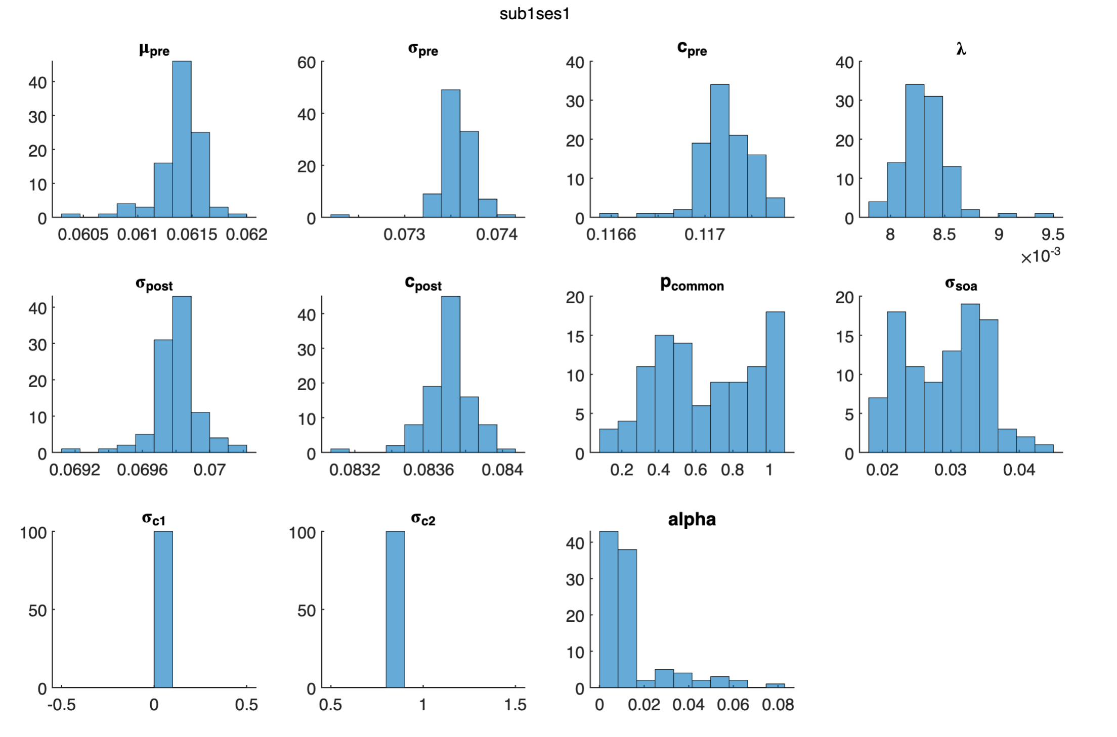
Model fitting_v2: distribution of parameters

Slide 23
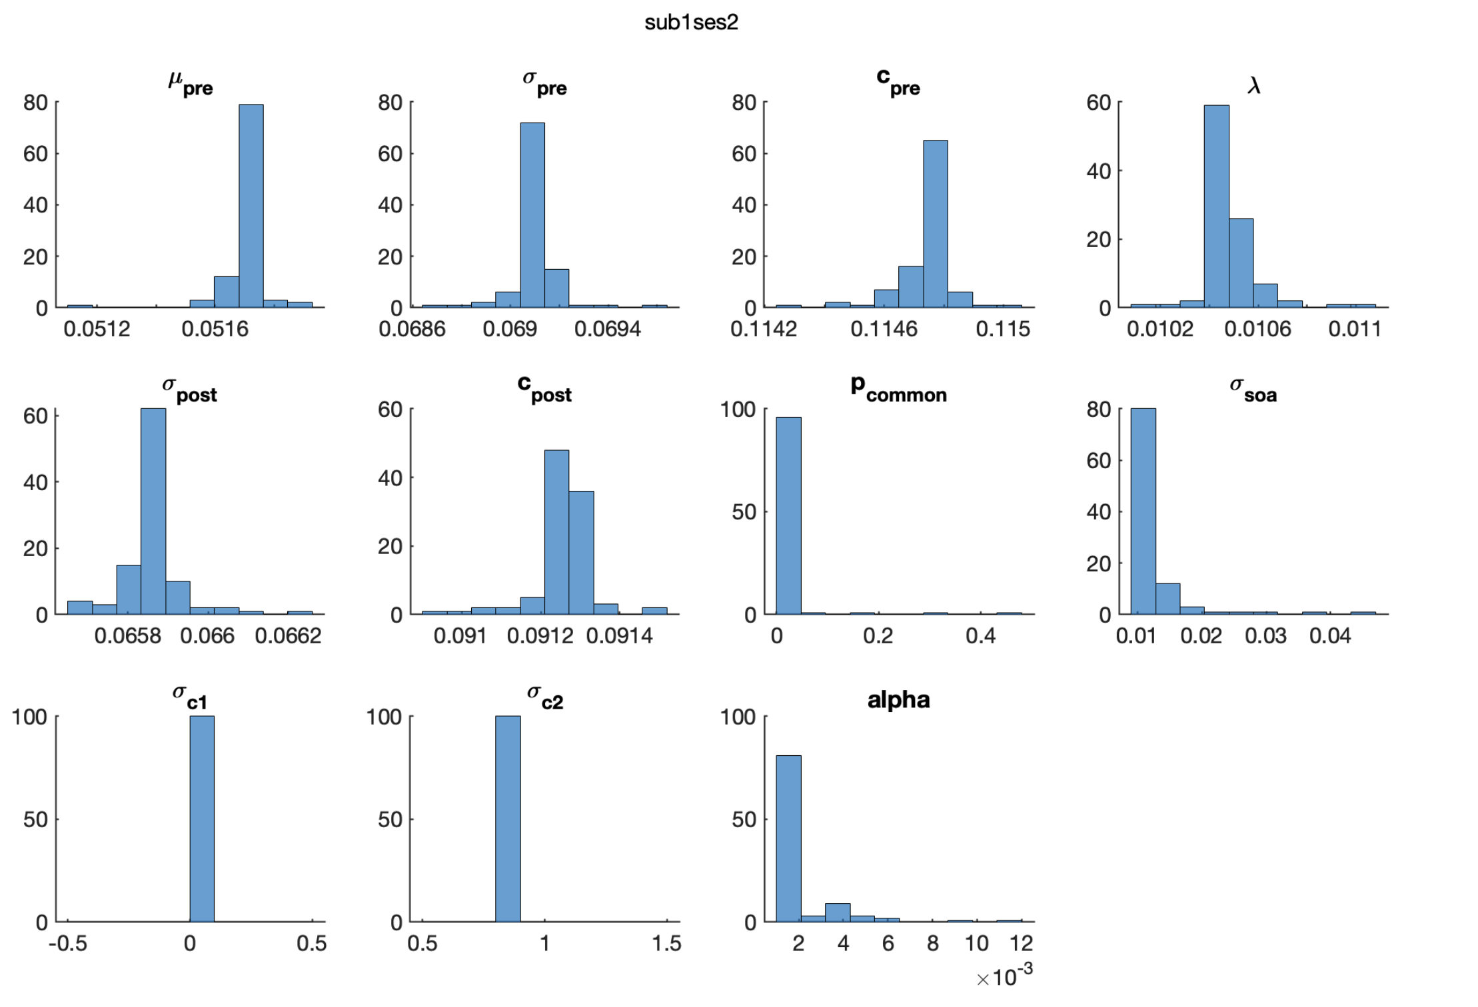
Model fitting_v2: distribution of parameters

Slide 24
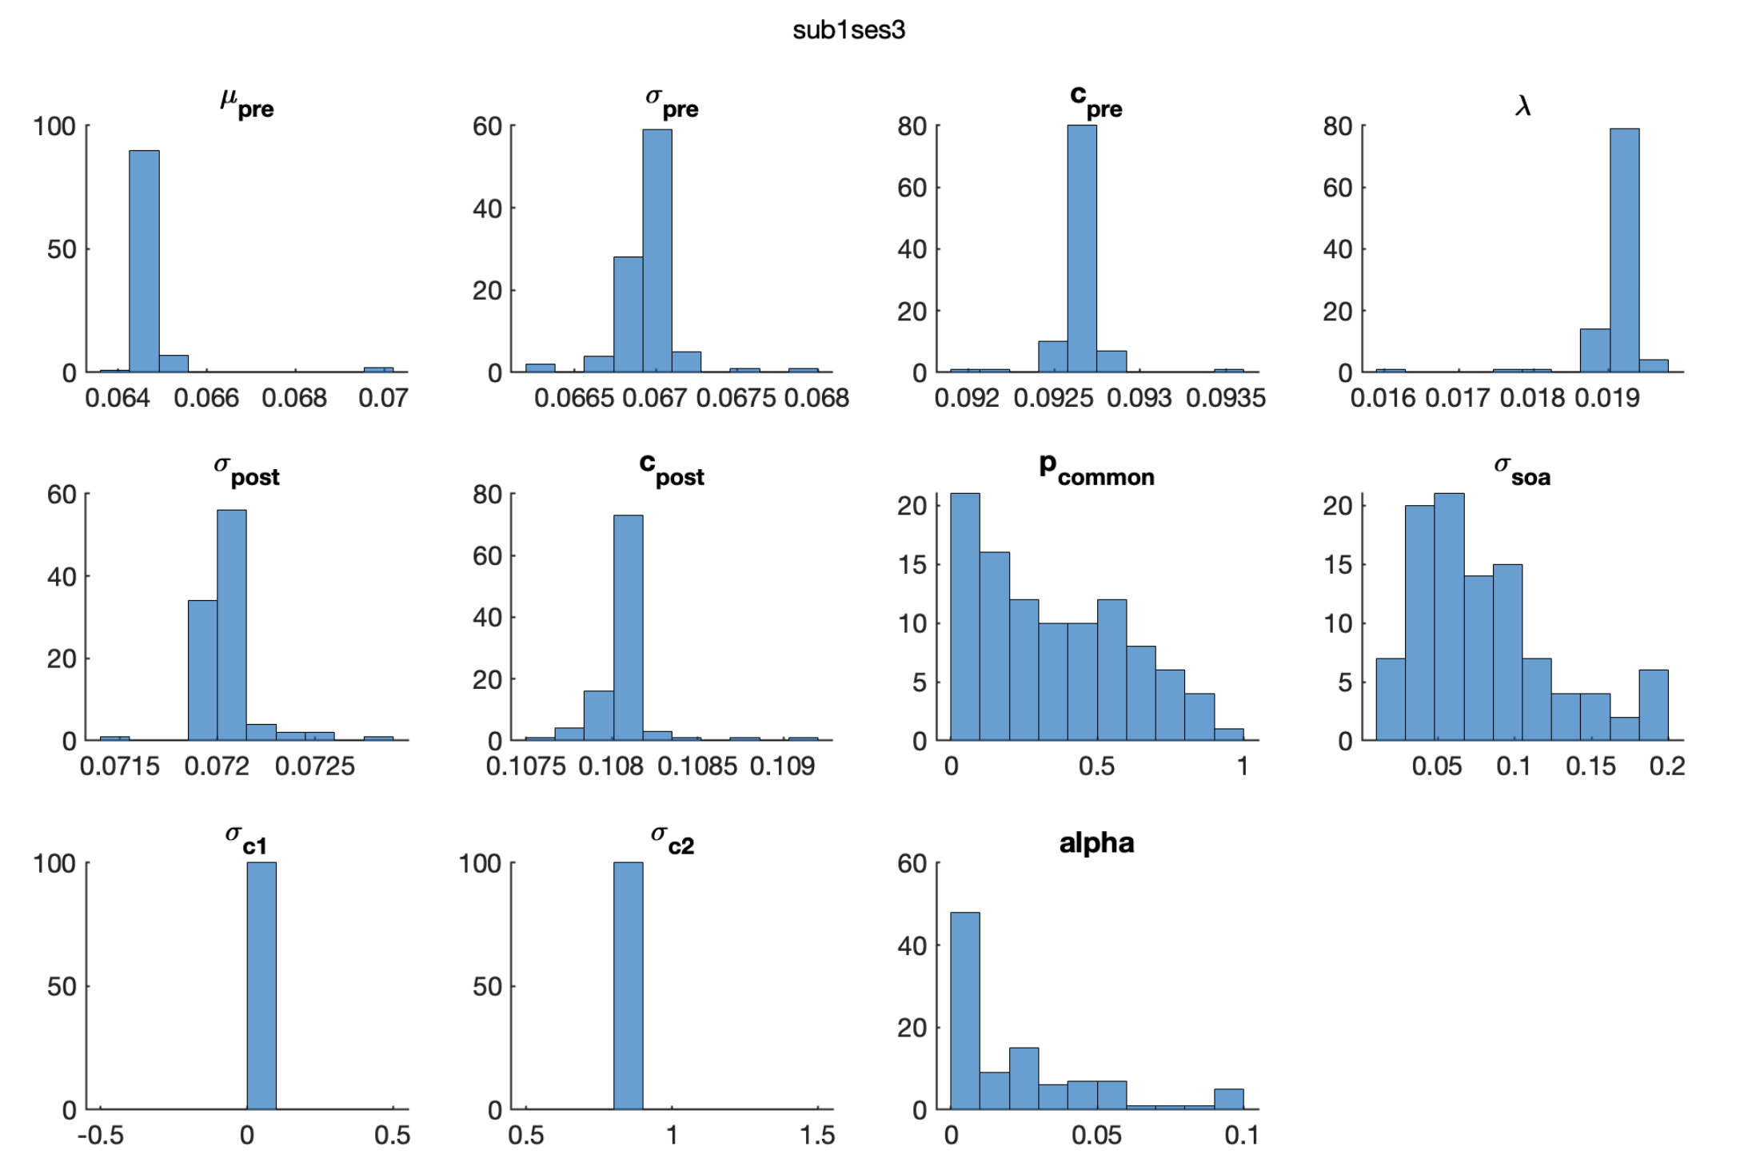
Model fitting_v2: distribution of parameters

